Slide 1

Olist Company Analysis
Amro Abdelqader
Braa Abu Saif

Slide 2

About Dataset
Data is for Olist Brazilian E-Commerce company.
Data were collected from 2015 to 2016.

Slide 3

Analysis Objectives
Provide analysis of sales and sellers.
Provide analysis of your highest purchasing customers.
Provide analysis of products and prices.

Slide 4
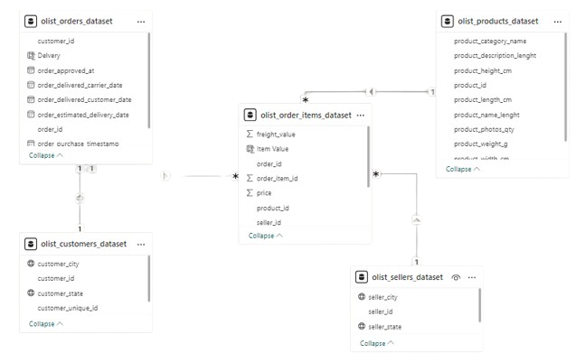
Data Modeling (Snowflake Schema)

Slide 5

Transformation
There were products with no name or ID and they made up 3% of the data in the products table. We removed them.
Cancelled orders do not have a delivery date and represent 1% of the data we have left.
There are some columns with date and time type that we converted to date type.
There are some useless Zip code columns that we have removed.

Slide 6

DAX
We calculated a new column called item value which is the sum of price and freight_value in the order item table.
We created a new column called delivery which is the number of days it will take for the order to arrive from the date the order is accepted until the date the order arrives using DATEDIFF.
We created new dimensions such as number of customers, number of sales and number of sellers.

Slide 7
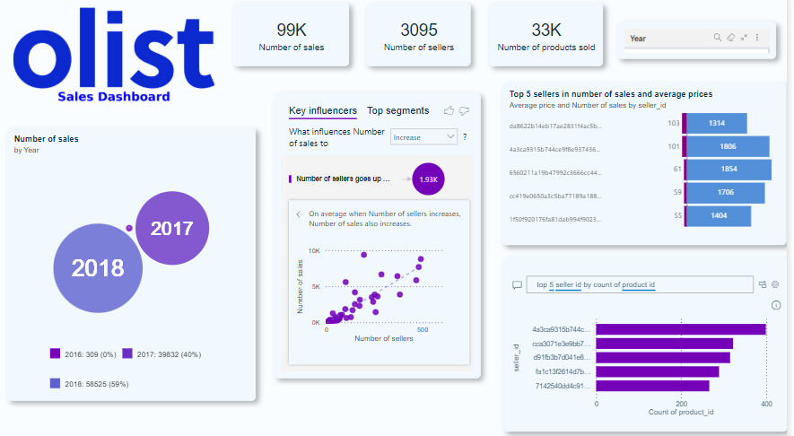
Sales Dashboard
Top seller with 1314 sales and average price of 103
The highest selling product category is cama mesa banho with 9417 sales.
The highest product category by number of sellers is beleza saude with 492 sellers.
The highest number of products for a seller is 399.

Slide 8
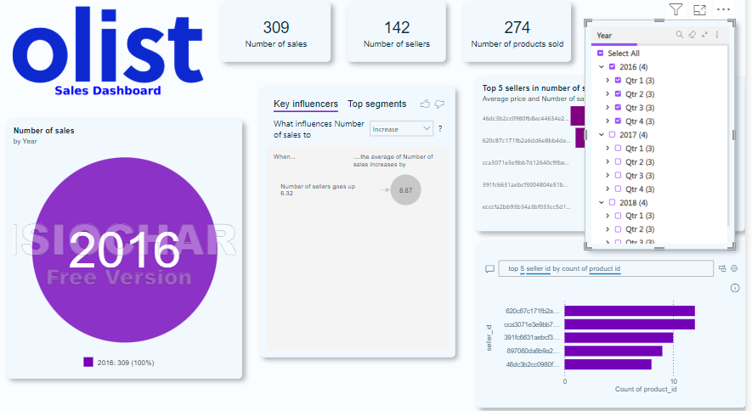
Sales Dashboard ( Filtered)

Slide 9
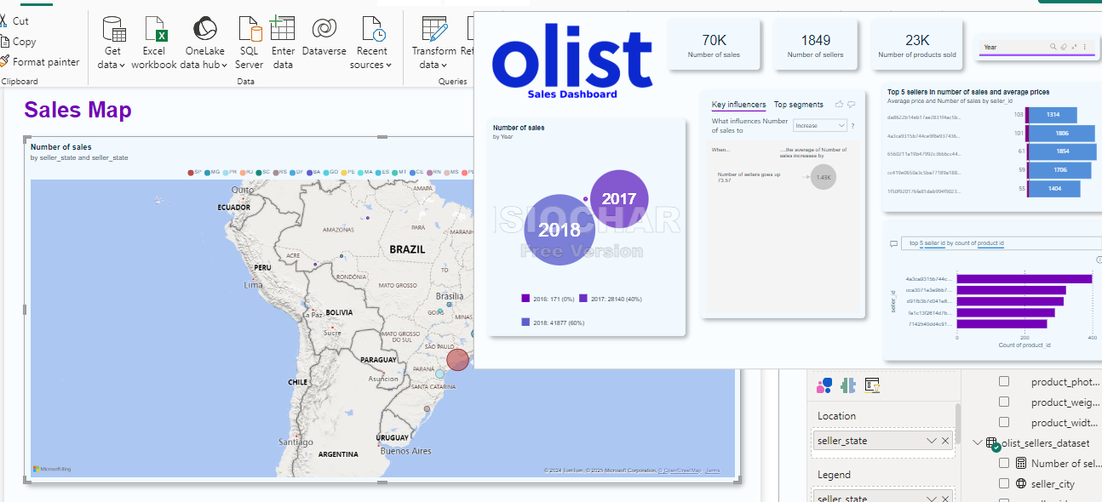
Sales Map
Used tooltips , integrate sales Map with Sales Dashboard
The highest state in terms of sales is SP and the lowest is AC.

Slide 10
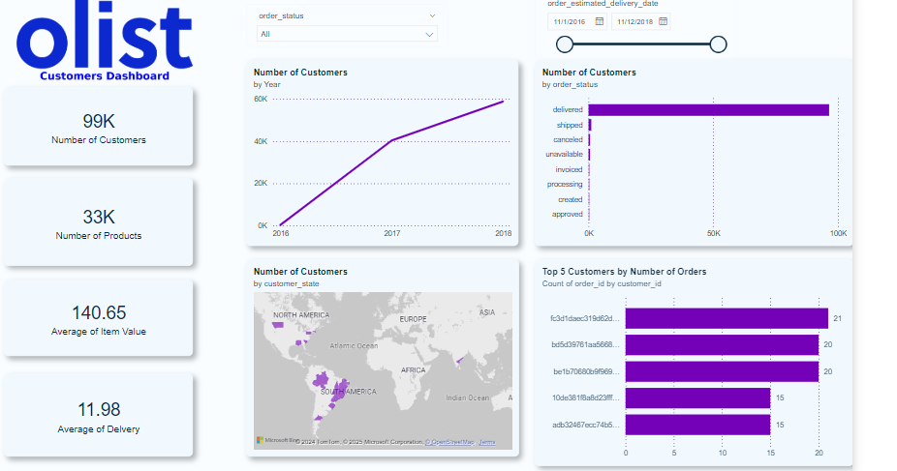
Customers Dashboard

Slide 11

Conclusion
The highest year of sales and number of customers is 2018.
The state with the most customers is AB and the highest sales is SP.
The highest seller achieved 1314 sales.
the highest customer bought 21 products.

Slide 12
Thank You

